Slide 1
Finding Transfer Function for Neural PD Controller
Tiffany Hamstreet
May 31, 2018

Slide 2
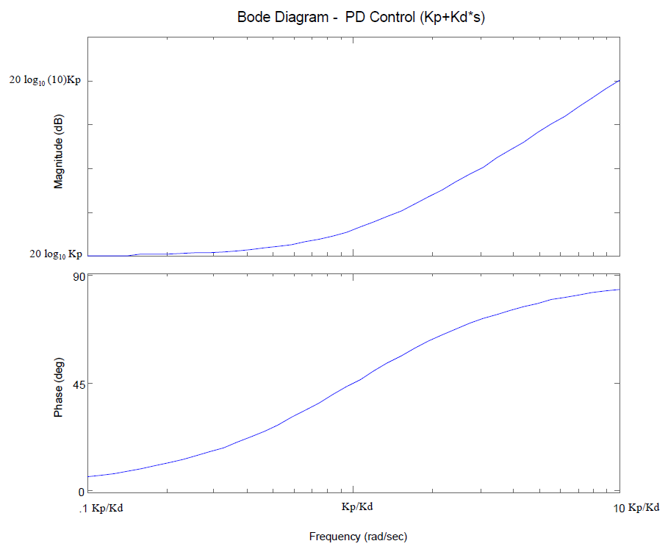
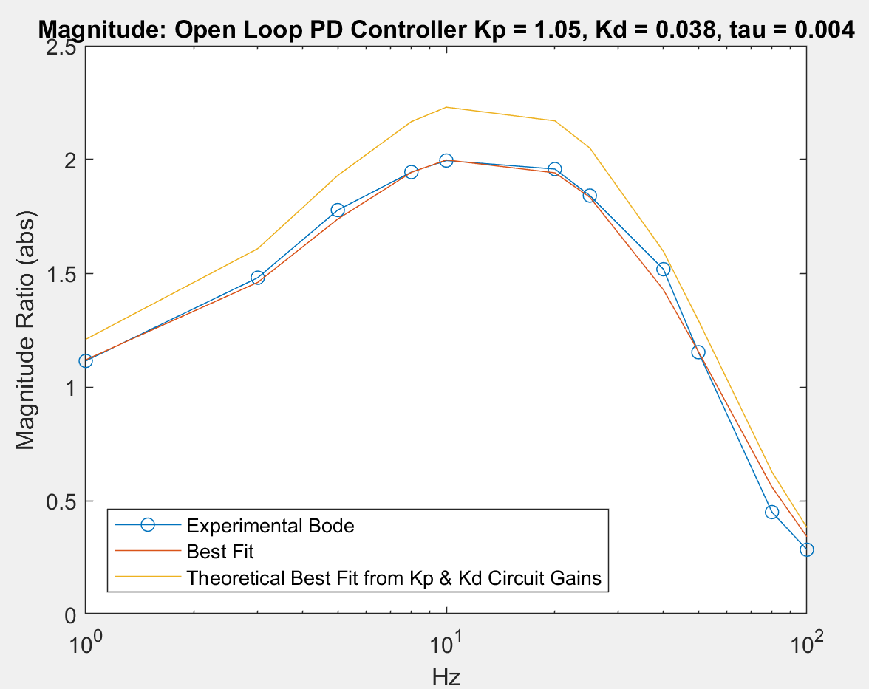
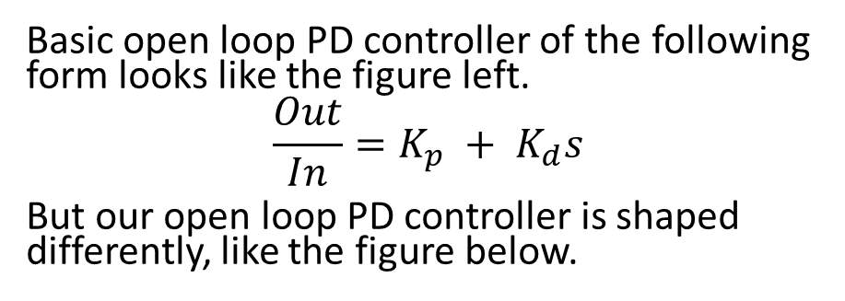
Basic PD Controller Frequency Response
Basic open loop PD controller of the following form looks like the figure left.
$${\frac{Out}{In}=K}_{p} + K_{d}s$$
But our open loop PD controller is shaped differently, like the figure below.

Slide 3
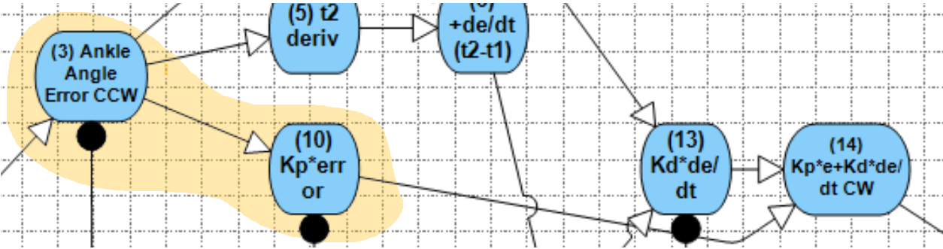
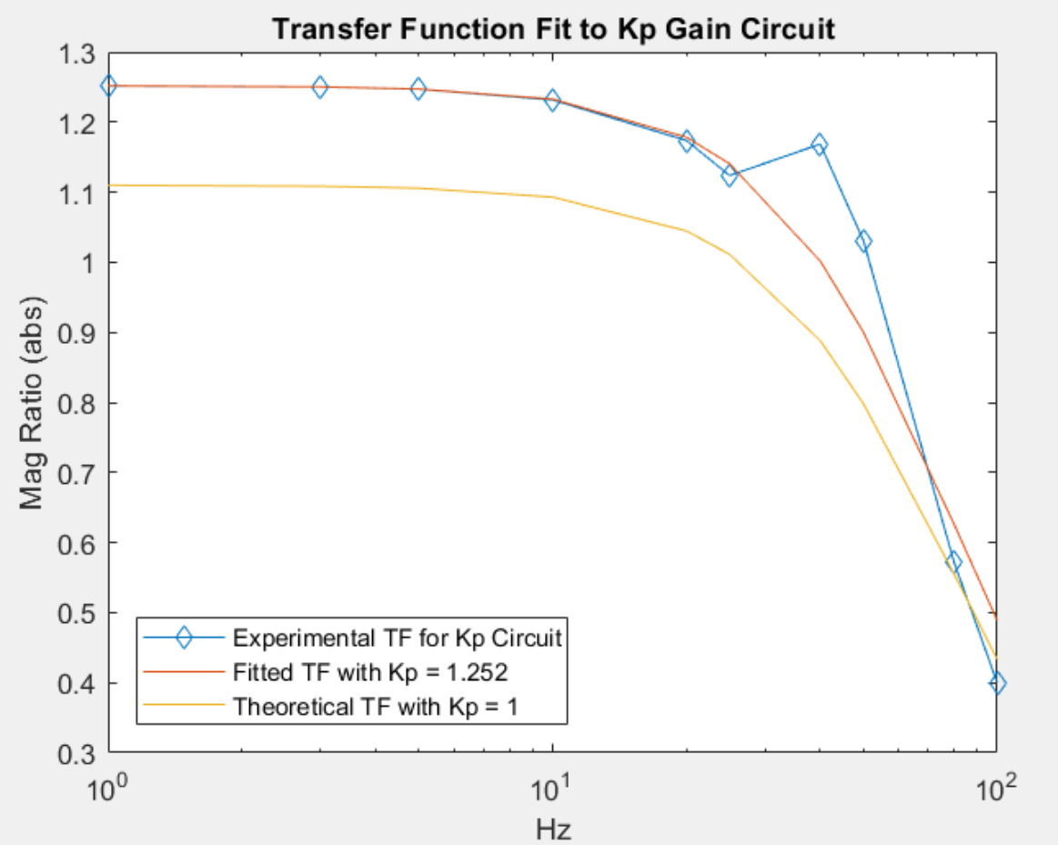
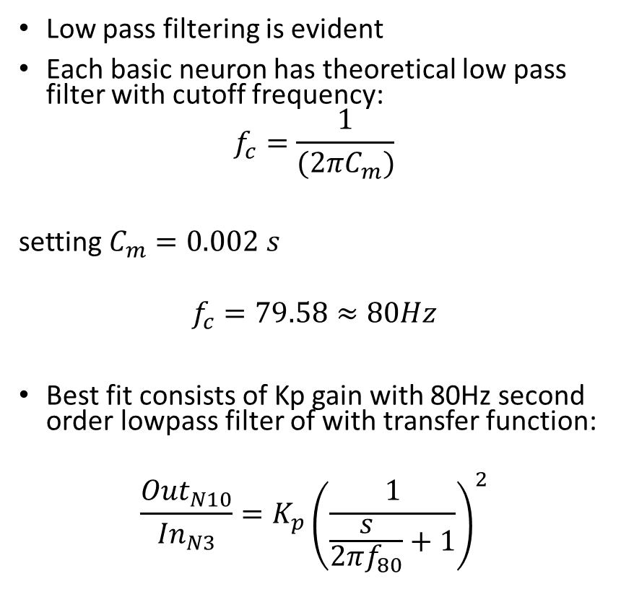
Isolating Kp Gain Circuit
Low pass filtering is evident
Each basic neuron has theoretical low pass filter with cutoff frequency:
$$f_{c}=\frac{1}{(2πC_{m})}$$
setting $C_{m}=0.002 s$
$$f_{c}=79.58≈80Hz$$
Best fit consists of Kp gain with 80Hz second order lowpass filter of with transfer function:
$$\frac{{Out}_{N10}}{{In}_{N3}}=K_{p}{\left(\frac{1}{\frac{s}{2πf_{80}}+1}\right)}^{2}$$

Slide 4
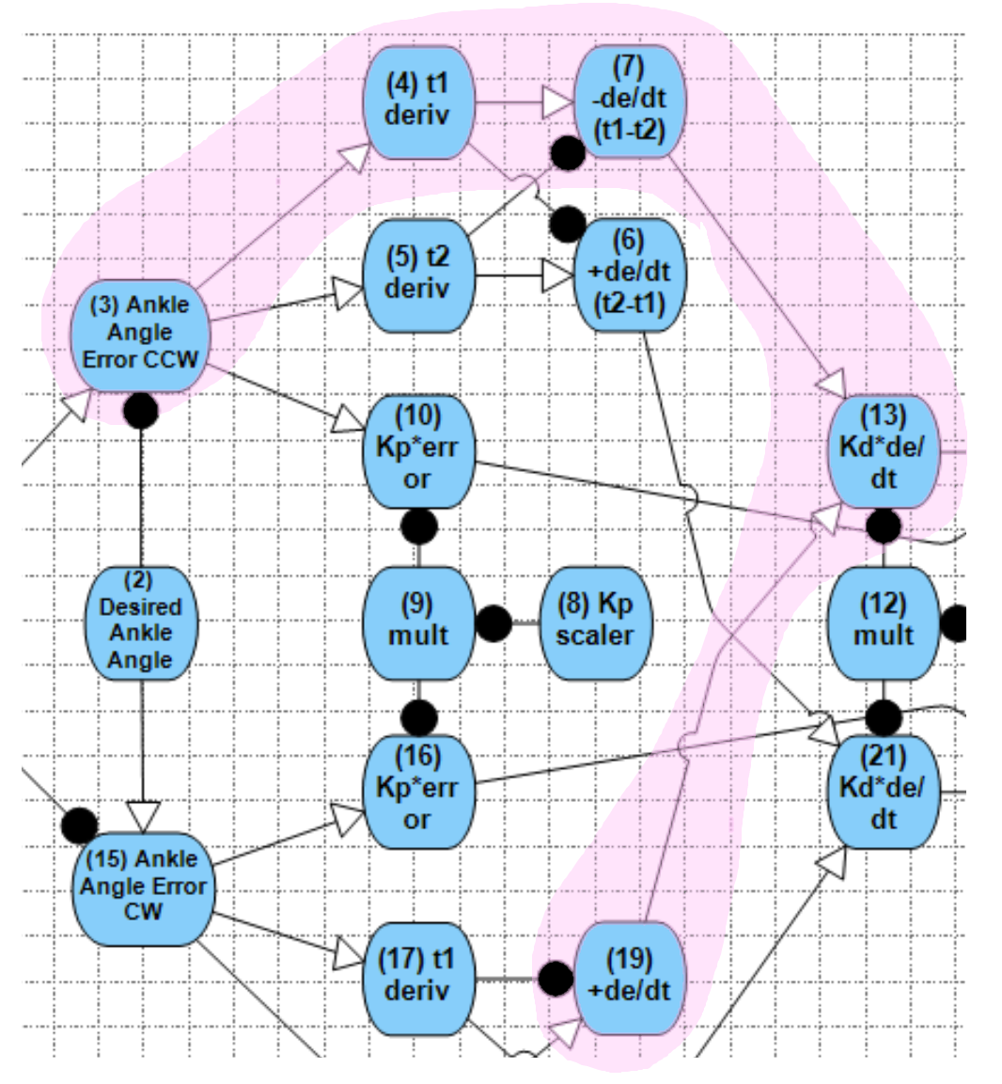
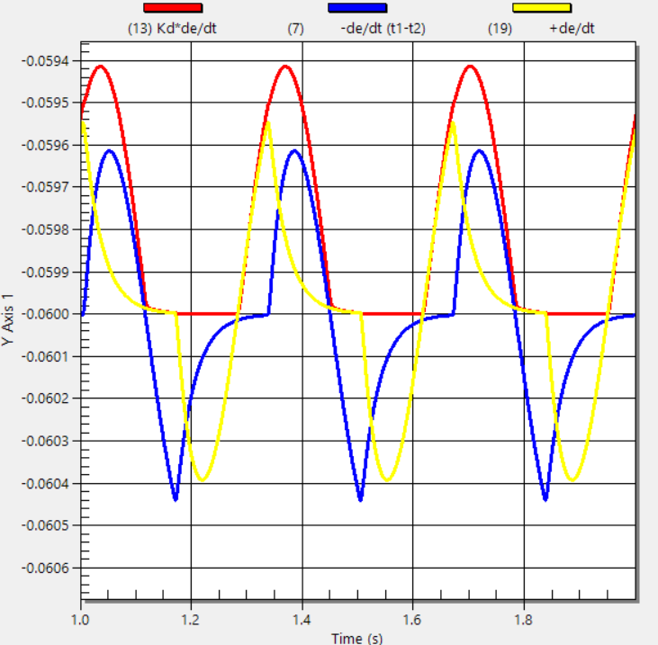
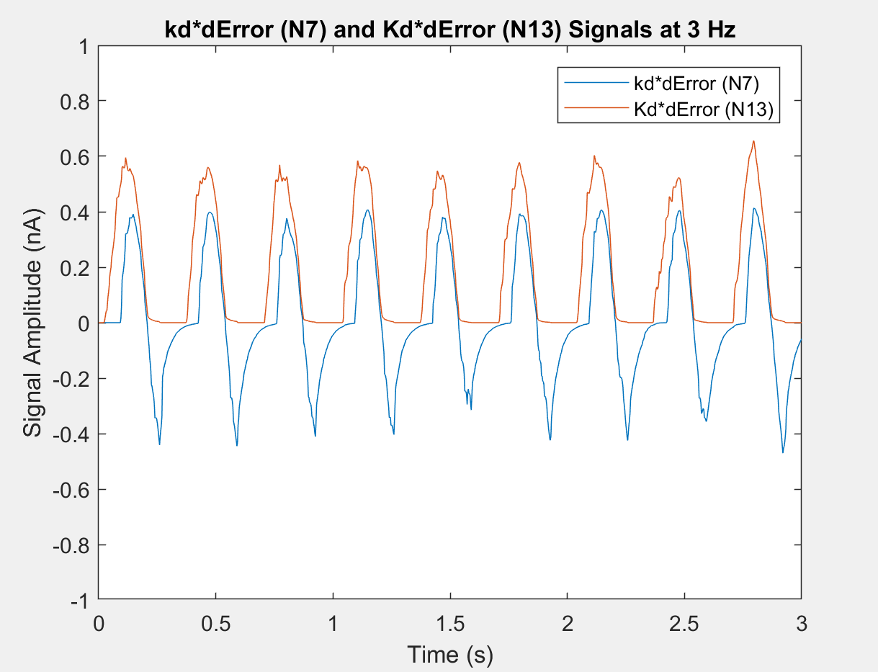
Derivative Circuit Behaves as Intended
Actual behavior of Derivative Circuit (with N7 input Only)
Derivative Network
Ideal behavior of Derivative Circuit at Neuron 13

Slide 5
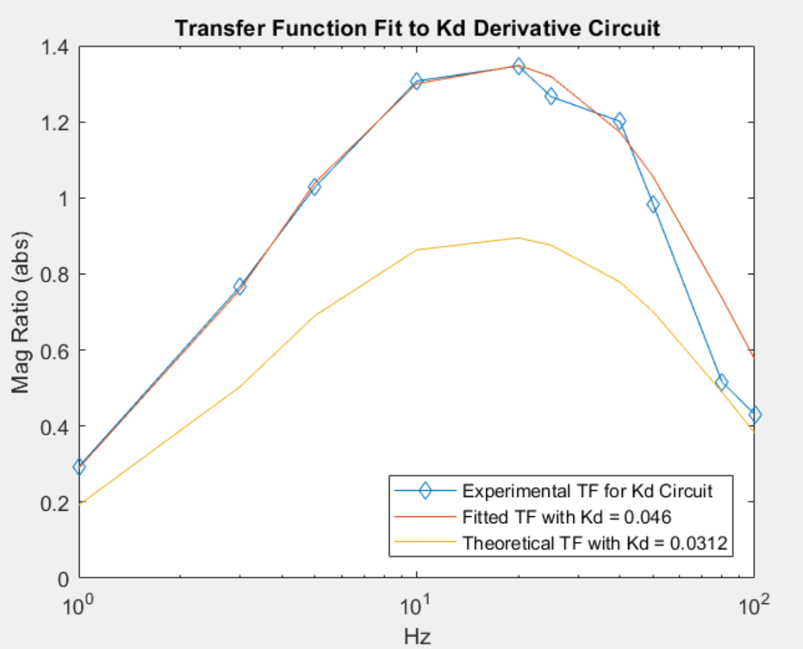
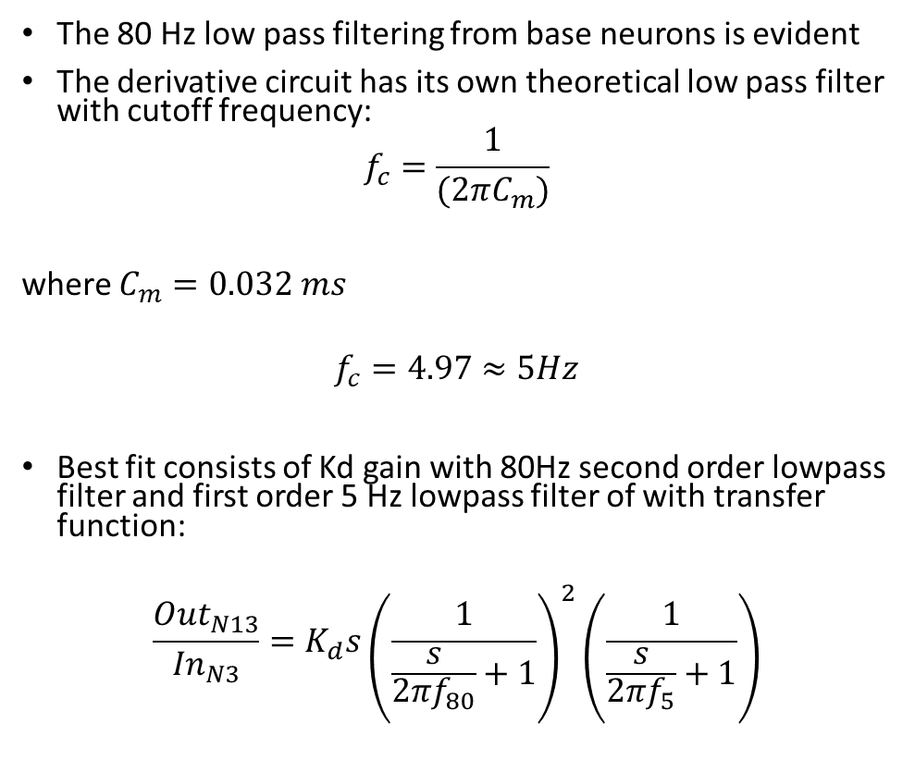
Isolating Derivative Circuit
The 80 Hz low pass filtering from base neurons is evident
The derivative circuit has its own theoretical low pass filter with cutoff frequency:
$$f_{c}=\frac{1}{(2πC_{m})}$$
where $C_{m}=0.032 ms$
$$f_{c}=4.97≈5Hz$$
Best fit consists of Kd gain with 80Hz second order lowpass filter and first order 5 Hz lowpass filter of with transfer function:
$$\frac{{Out}_{N13}}{{In}_{N3}}=K_{d}s{\left(\frac{1}{\frac{s}{2πf_{80}}+1}\right)}^{2}\left(\frac{1}{\frac{s}{2πf_{5}}+1}\right)$$

Slide 6
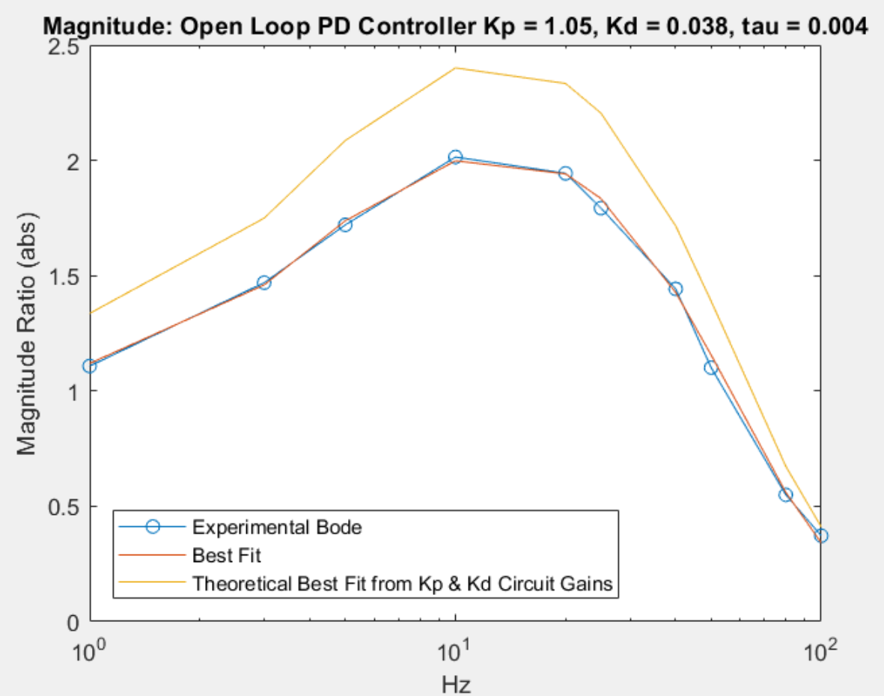
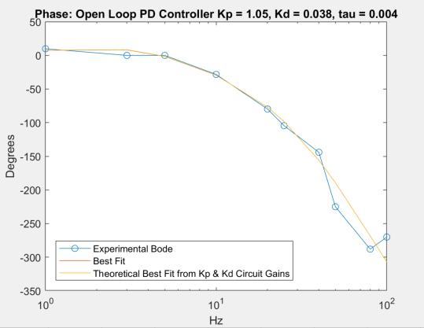
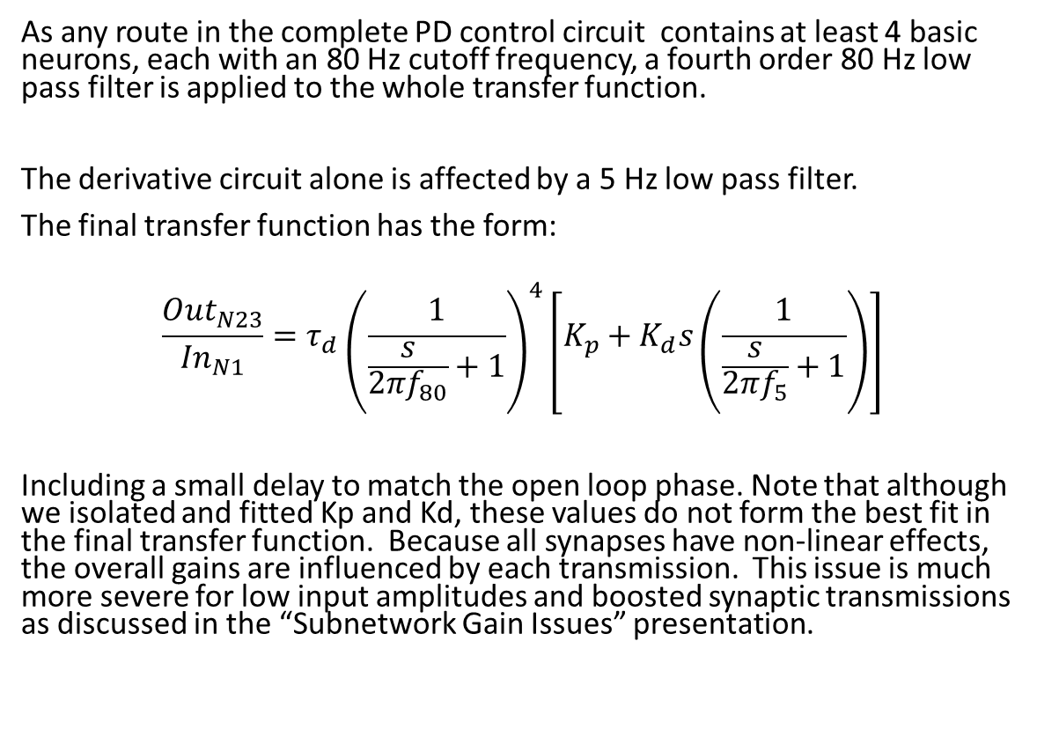
Final Open Loop PD Controller Transfer Function
As any route in the complete PD control circuit contains at least 4 basic neurons, each with an 80 Hz cutoff frequency, a fourth order 80 Hz low pass filter is applied to the whole transfer function.
The derivative circuit alone is affected by a 5 Hz low pass filter.
The final transfer function has the form:
$$\frac{{Out}_{N23}}{{In}_{N1}}={τ_{d}\left(\frac{1}{\frac{s}{2πf_{80}}+1}\right)}^{4}\left[K_{p}+K_{d}s\left(\frac{1}{\frac{s}{2πf_{5}}+1}\right)\right]$$
Including a small delay to match the open loop phase. Note that although we isolated and fitted Kp and Kd, these values do not form the best fit in the final transfer function. Because all synapses have non-linear effects, the overall gains are influenced by each transmission. This issue is much more severe for low input amplitudes and boosted synaptic transmissions as discussed in the “Subnetwork Gain Issues” presentation.

Slide 7
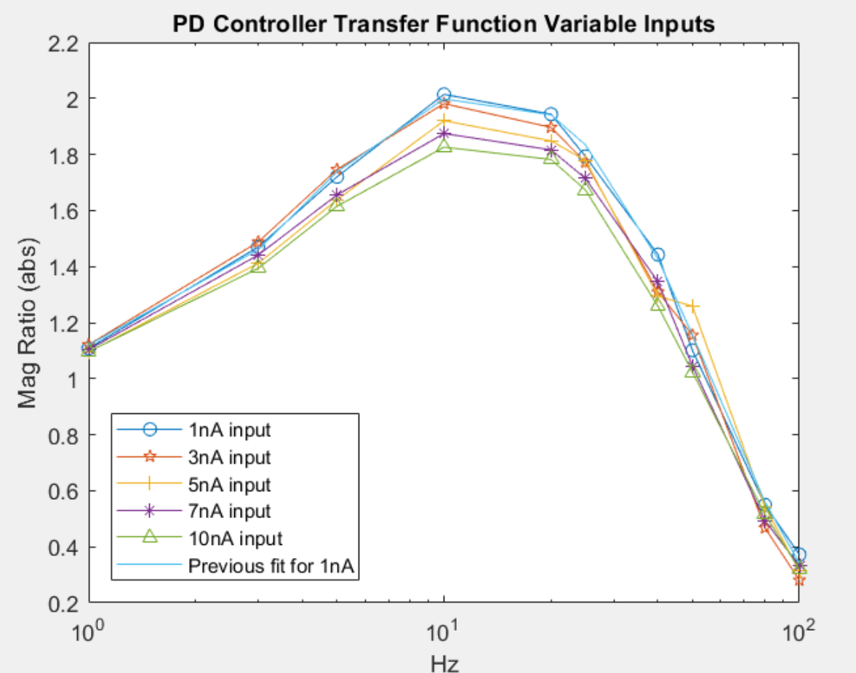
Effect of Varying Input to Open Loop PD (given all base synaptic transmission settings)
Overall gain appears to decrease as input increases, but is very roughly constant.

Slide 8
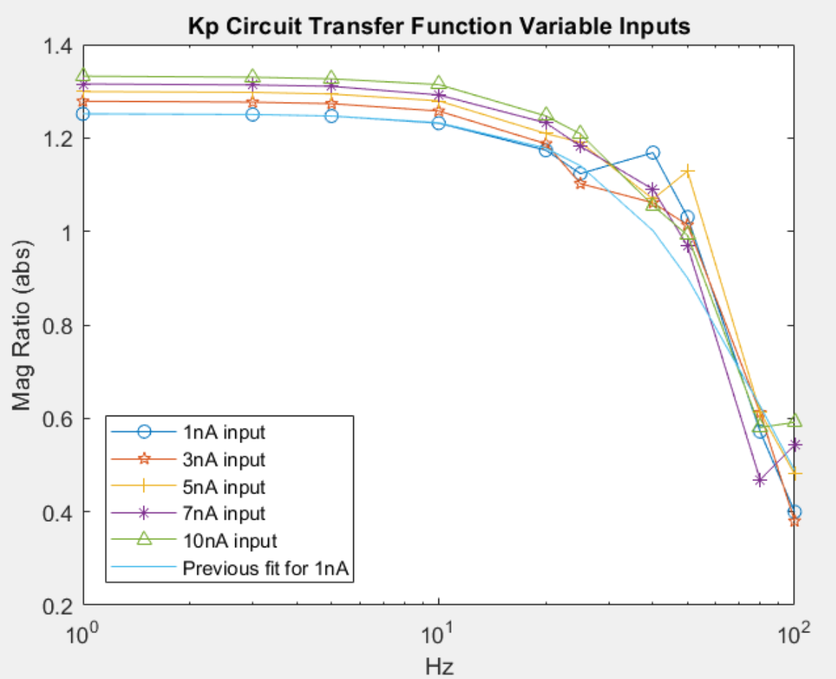
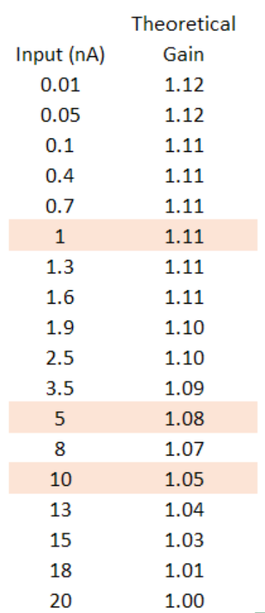
Kp - Effect of Varying Input
Increasing input increases Kp by roughly 3.5% per 5nA input (essentially constant over small input ranges, say 1nA)
But theory tells us that if anything, Kp gain should decrease slightly for higher inputs

Slide 9
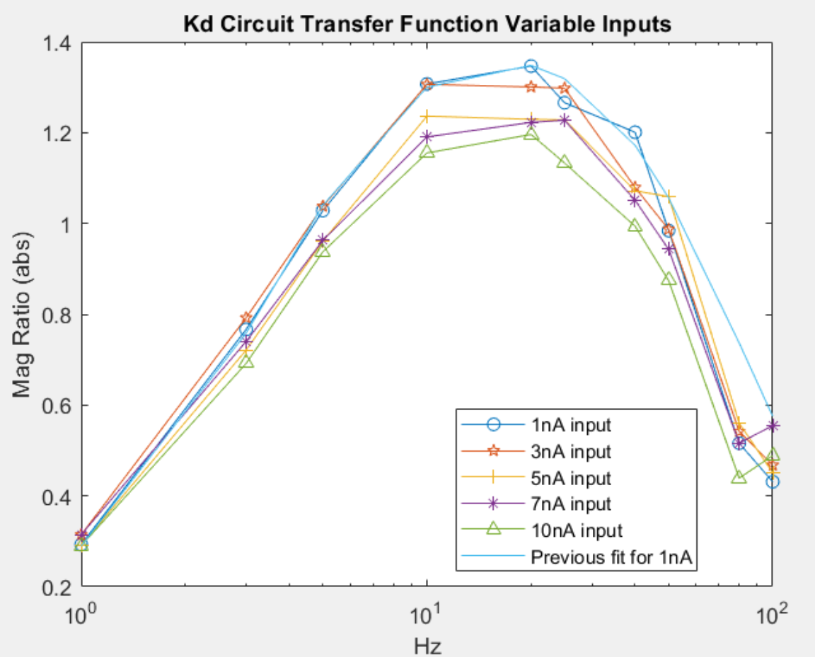
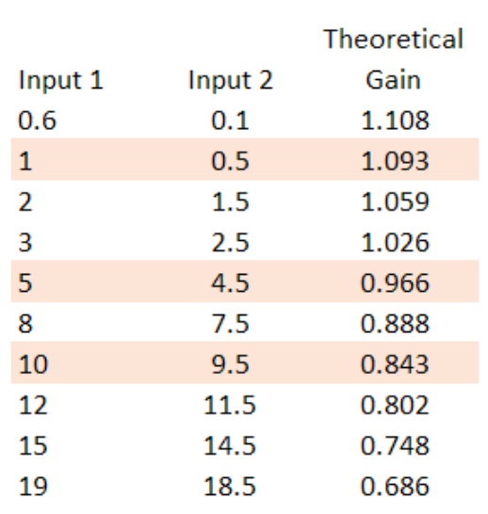
Kd - Effect of Varying Input
Increasing input decreases Kd by about 7% per 5nA input
Theory tells us that Kd gain should decrease by about 12% per 5nA input, but this circuit involves a transmission synapse which should counteract this decrease somewhat

Slide 10
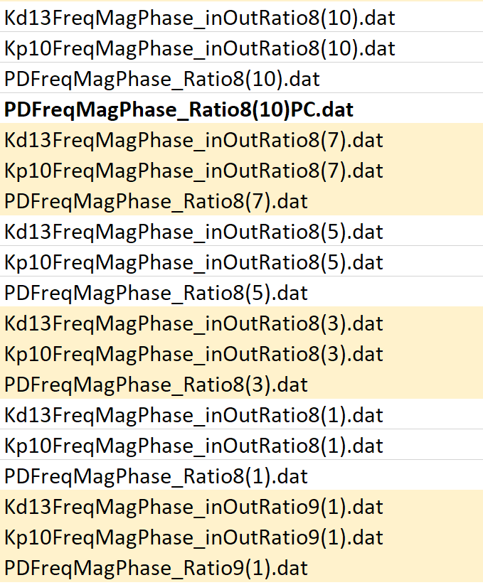
Matlab Scripts and Datasets Used Herein
Matlab Scripts and other Files
Datasets – (#) indicates amplitude used for Auto Bode data collection
To generate data:
Open_Loop_Serial_Auto_Bode_KpKd_allFiles.m
Utilizes Auto_Bode.m (from Dr. Turcic directly)
Auto_Bode_Tiff.m (modified output files)
To generate open loop TF fits for overall PD Controller:
openLoop_PD_controller.m
Manual Phase.xlsx
Manually corrected phase plot from IO data for open loop PD
To generate TF fits for Kd and Kp components of PD Controler:
Extract_Kp_TF.m
To generate varied input plots:
Batch_Bodes_MagKpKd.m
To generate time domain Output and Input data for PD, Kp, Kd
NN_read_IOdata_files.m

